Slide 1
An explanation of the CDI Fulltext Linking types
Yoel Kortick
Senior Librarian

Slide 2

Introduction
Electronic Collections which will be used in the examples here
An example with Link in record
Another example with Link in record
An example with Link Resolver
Agenda

Slide 3
Introduction

Slide 4
Introduction
In addition to this presentation, it is also recommended to see CDI and Linking to Electronic Full Text
Primo supports three types of CDI Full Text Linking:
Link In record
Link Resolver (sometimes also referred to as "OpenURL linking")
Hybrid
This presentation will explain the "Link In record" and "Link Resolver" types and provide examples.
The definitions of "Link In Record" and "Link Resolver" is not something which can be changed by the Alma institution. This presentation is merely to explain the behavior of each method.

Slide 5
Introduction
This presentation will not be explaining the "Hybrid" method.
For more information about the "Hybrid" method, see Hybrid Collections in CDI

Slide 6
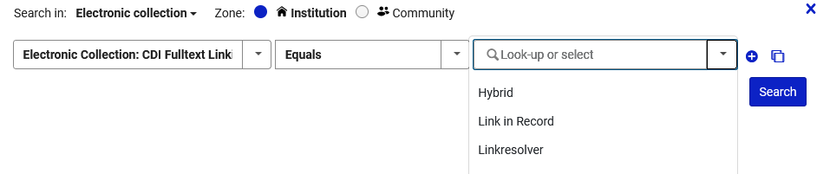
Introduction
The CDI Fulltext Linking type is defined in Alma on the level of the electronic collection.
In Alma the electronic resources can be searched by this value as follows:
1. where (CDI Fulltext Linking equals "Link in Record")
2. where (CDI Fulltext Linking equals "Linkresolver")

Slide 7
Introduction
Link in Record = the link to the Full Text is already in the record, as part of the PNX linking method
  Explanation of this method from CDI and Linking to Electronic Full Text: Link in Record – In cases where the record is uniquely available from a single platform and/or the link is difficult or impossible to create using the link resolver, Primo will use the link stored in the record, which has been provided by the information provider, in CDI. This method is used for approximately 40 percent of the collections. Collections that use this method include, for example, video collections (such as Alexander Street Press), some reference collections, or collections that contain special and unique material.

Slide 8
Introduction
Link in Resolver = An openURL is sent to alma to find a match with the available electronic resource (electronic portfolio)
  Explanation of this method from CDI and Linking to Electronic Full Text: OpenURL linking – Full text linking is handled by the link resolver (Alma/SFX), which allows the library to decide which links to display and their order. Where possible, Primo will add a platform-specific document ID to the OpenURL to allow the link resolver to use that ID to link to the full text instead of using metadata to create the link. This ensures a higher reliability of the links. OpenURL linking is used for approximately 60 percent of the collections indexed in CDI. Collections that use this method include primary publishers and, in general, collections that contain mainstream material such as articles and books that may be available from more than one platform.

Slide 9
Electronic Collections which will be used in the examples here

Slide 10
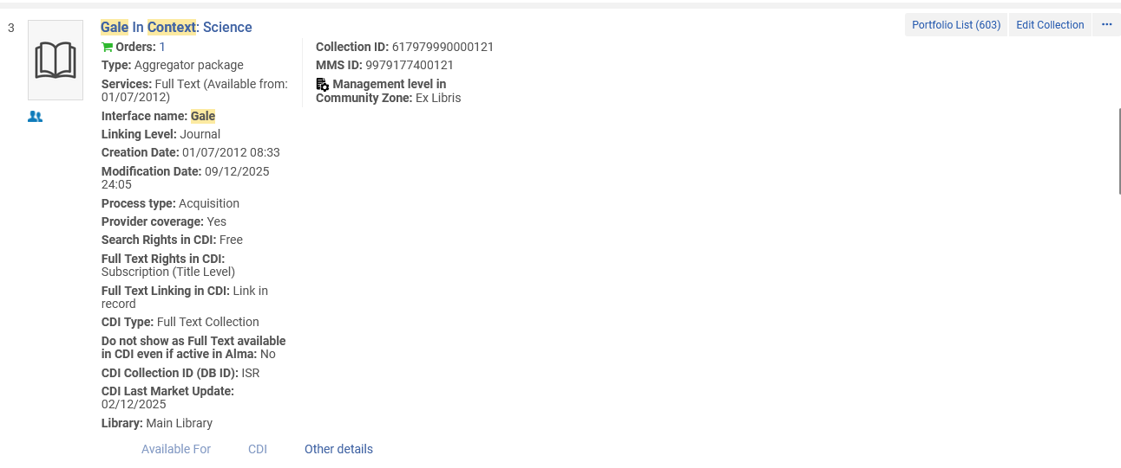
Electronic Collections which will be used in the examples here
Electronic Collection Gale in Context: Science, for example, is "Full Text Linking in CDI: Link in record"
Link in record
Repository Search Results

Slide 11
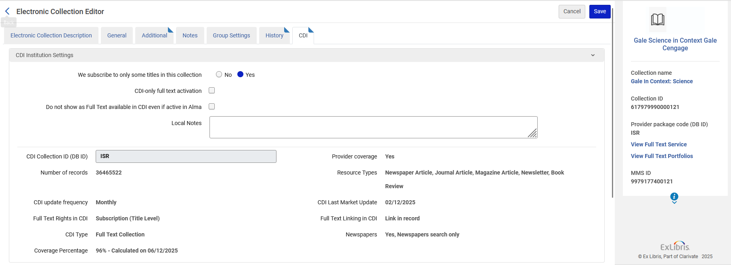
Electronic Collections which will be used in the examples here
Electronic Collection Gale in Context: Science, for example, is "Full Text Linking in CDI: Link in record"
Link in record
Electronic Collection Editor

Slide 12
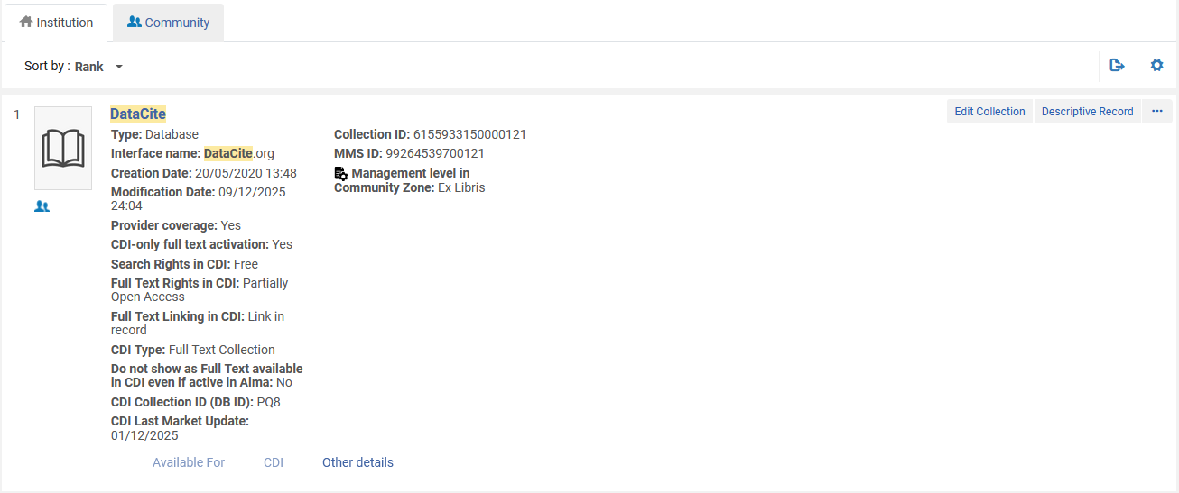
Electronic Collections which will be used in the examples here
Electronic Collection DataCite, for example, is also "Full Text Linking in CDI: Link in record"
Link in record
Repository Search Results

Slide 13
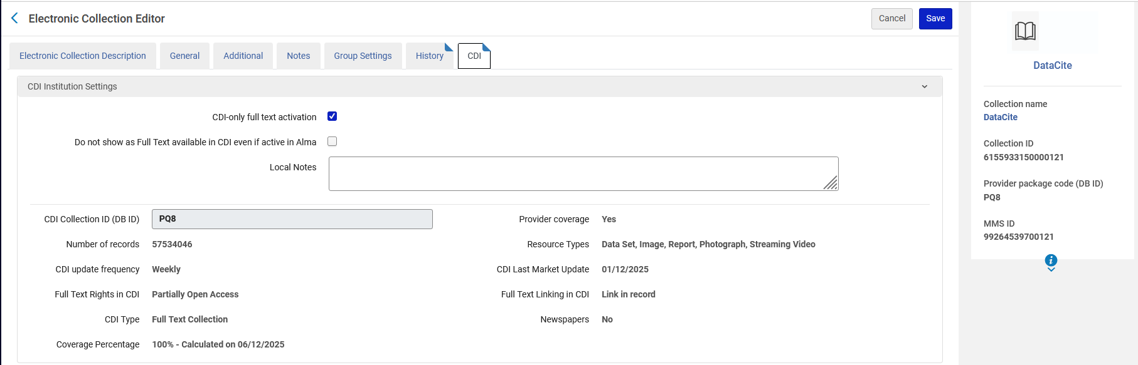
Electronic Collections which will be used in the examples here
Electronic Collection DataCite, for example, is also "Full Text Linking in CDI: Link in record"
Link in record
Electronic Collection Editor

Slide 14
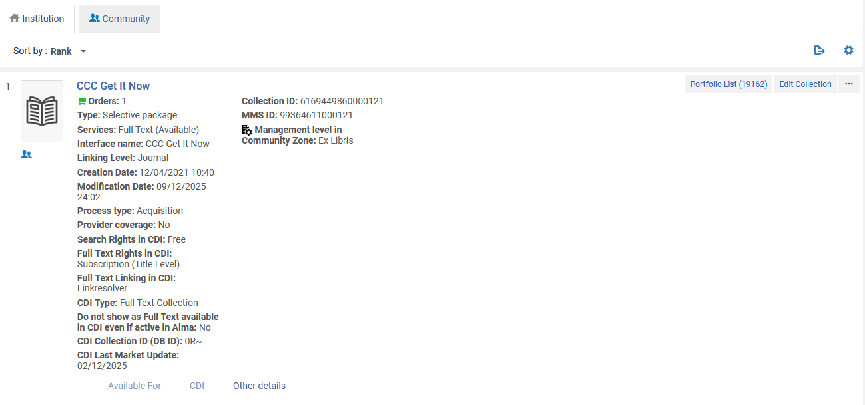
Electronic Collections which will be used in the examples here
Electronic Collection CCC Get It Now, for example, is "Full Text Linking in CDI: Linkresolver"
Link Resolver
Repository Search Results

Slide 15
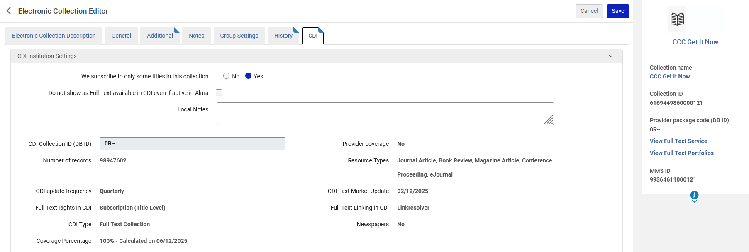
Electronic Collections which will be used in the examples here
Electronic Collection CCC Get It Now, for example, is "Full Text Linking in CDI: Linkresolver"
Link Resolver
Electronic Collection Editor

Slide 16
An example with Link in record

Slide 17
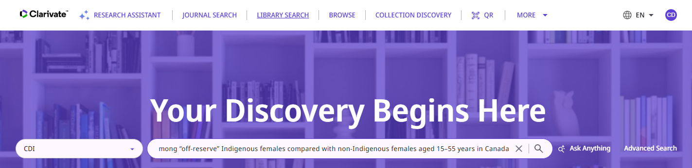
An example with Link in record
In Primo we search CDI for article "Disparities in primary and emergency health care among "off-reserve" Indigenous females compared with non-Indigenous females aged 15–55 years in Canada"

Slide 18
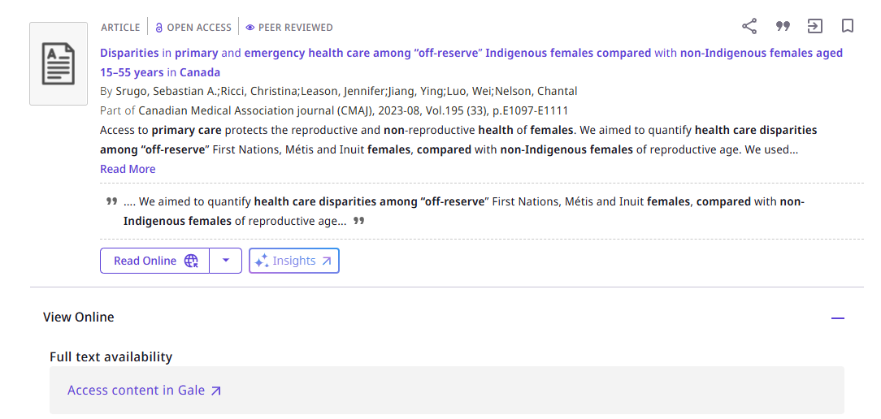
An example with Link in record
After viewing the results we will click "Access content in Gale"
With "Link in record" method, it gives the name of the interface proceeded by "Access content in" as the link

Slide 19

An example with Link in record
It goes directly to a link (which is coming from the record in CDI) and does not use the Link Resolver.
It goes directly to https://link.gale.com/apps/doc/A762607561/SCIC?sid=summon&u=sfx_loc1
After arriving to https://link.gale.com/apps/doc/A762607561/SCIC?sid=summon&u=sfx_loc1
Gale changed it to https://galeapps.gale.com/apps/auth?userGroupName=sfx_loc1
There was no link resolver used here.

Slide 20
An example with Link in record
On a technical level, when using "Link in record" the following appears in the "links" and "delivery" sections of the PNX of the record:
<links>
<openurl>$$Topenurl_article</openurl>
<openurlfulltext>$$Topenurlfull_article</openurlfulltext>
<thumbnail>$$Tsyndetics_thumb_exl</thumbnail>
<linktohtml>$$Uhttps://www.proquest.com/docview/2872343198?pq-origsite=primo$$EHTML$$P50$$Gproquest$$H</linktohtml>
<linktorsrc>$$Uhttps://link.gale.com/apps/doc/A762607561/SCIC?sid=summon&amp;u=sfx_loc1$$EView_record_in_Gale$$FView_record_in_$$GGale</linktorsrc>
…
</links>
In the "linktorsrc" where we arrived after clicking "Access Content In …"
Here the "fulltext" value is "fulltext_multiple" when using "Link in record"
We will soon see another example where the fulltext value is "fulltext_linktorsrc" when using "Link in record"
<delivery>
<delcategory>Remote Search Resource</delcategory>
<fulltext>fulltext_multiple</fulltext>
</delivery>

Slide 21
Another example with Link in record

Slide 22
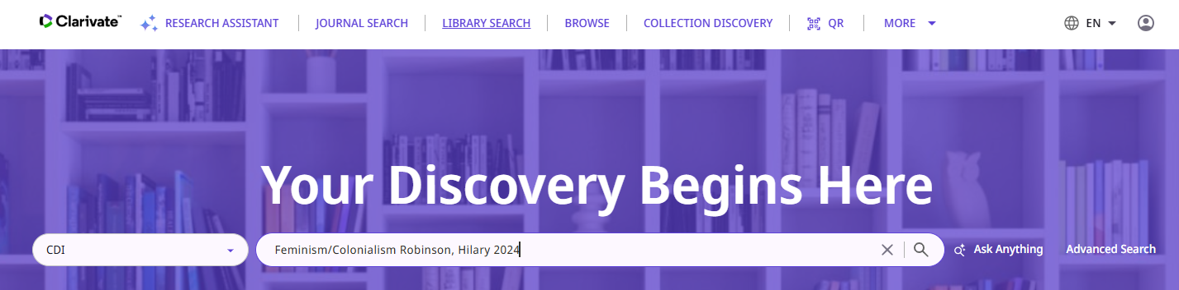
Another example with Link in record
In Primo we search CDI for video "Feminism/Colonialism" by Robinson, Hilary from 2024.

Slide 23
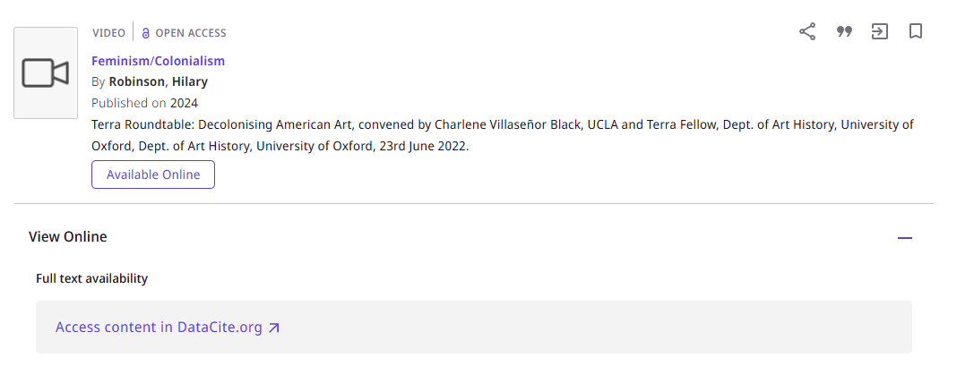
Another example with Link in record
After viewing the results, we will click "Access content in DataCite.org"
With "Link in record" method, it gives the name of the interface proceeded by "Access content in" as the link

Slide 24
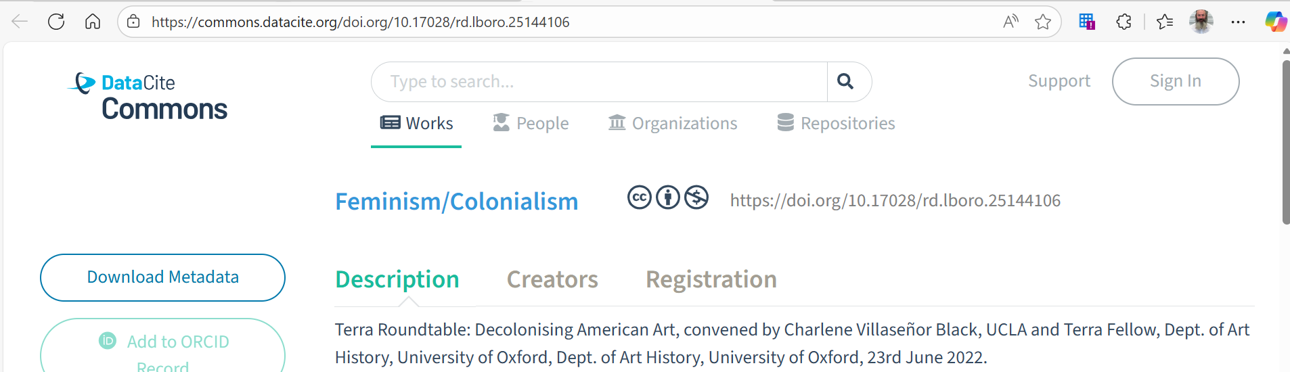
Another example with Link in record
It goes directly to a link (which is coming from the record in CDI) and does not use the Link Resolver.
It goes directly to https://commons.datacite.org/doi.org/10.17028/rd.lboro.25144106

Slide 25
Another example with Link in record
On a technical level, when using "Link in record" the following appears in the "links" and "delivery" sections of the PNX of the record:
In the "linktorsrc" where we arrived after clicking "Access Content In …"
<links>
<openurl>$$Topenurl_article</openurl>
<openurlfulltext>$$Topenurlfull_article</openurlfulltext>
<thumbnail>$$Tsyndetics_thumb_exl</thumbnail> <linktorsrc>$$Uhttps://commons.datacite.org/doi.org/10.17028/rd.lboro.25144106$$EView_record_in_DataCite.org$$FView_record_in_$$GDataCite.org$$Hfree_for_read</linktorsrc>
</links>
The "fulltext" value is is "fulltext_linktorsrc" when using "Link in record"
<delivery>
<delcategory>Remote Search Resource</delcategory>
<fulltext>fulltext_linktorsrc</fulltext>
</delivery>

Slide 26
An example with Link Resolver

Slide 27

An example with Link Resolver
In Primo we search CDI for article "Feminist Sociology and the Future of Work: A Tribute to Joan Acker and the AJS Special Issue on Women" by Williams, Christine L.".

Slide 28
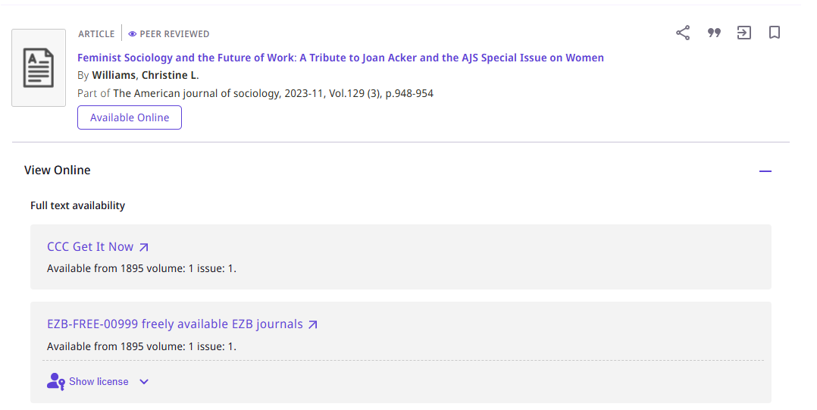
An example with Link Resolver
After viewing the results we will click "CCC Get It Now" (the Electronic Collection Name)
With Link Resolver method it gives the name of the Electronic Collection as the link

Slide 29
An example with Link Resolver
It uses the Link Resolver and does not go directly to a link.
It goes to: https://exldeveu00.primo.exlibrisgroup.com/view/action/uresolver.do?operation=resolveService&package_service_id=8404991540000121&institutionId=121&customerId=110&VE=true
The link resolver then resolves this URL and it and goes to https://www.journals.uchicago.edu/toc/ajs/current
It starts like this:
And then is resolved to this

Slide 30
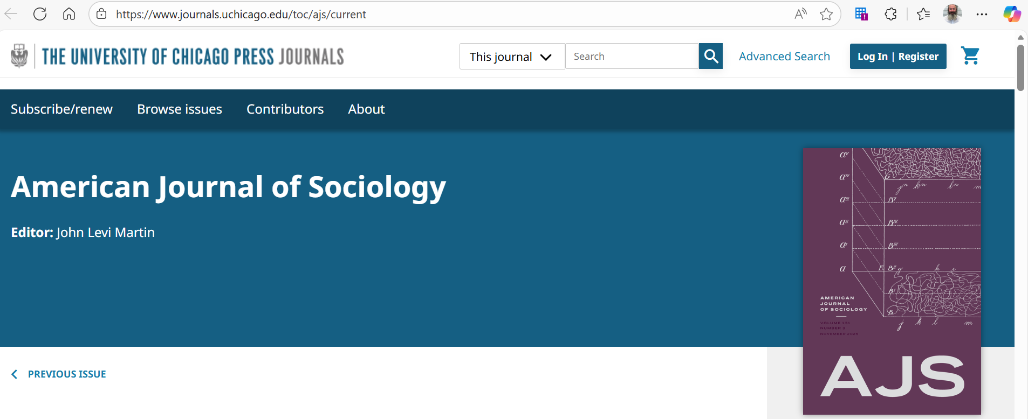
An example with Link Resolver
The user arrives to https://www.journals.uchicago.edu/toc/ajs/current

Slide 31
An example with Link Resolver
On a technical level, when using "Link in record" the following appears in the "links" and "delivery" sections of the PNX of the record:
There is no "linktorsrc" with a URL (as there was for the "Link in record" example)
<links>
<openurl>$$Topenurl_article</openurl>
<openurlfulltext>$$Topenurlfull_article</openurlfulltext>
<thumbnail>$$Tsyndetics_thumb_exl</thumbnail>
</links>
The delivery is "Fulltext" instead oif fulltext_linktorsrc" (as it was for the "Link in record" example)
<delivery>
<delcategory>Remote Search Resource</delcategory>
<fulltext>fulltext</fulltext>
</delivery>

Slide 32
xxx@exlibrisgroup.com

